Slide 1
The Farakka Barrage Project: Socio-environmental Implications
Jenia Mukherjee
Department of Humanities and Social Sciences
IIT KHARAGPUR

Slide 2
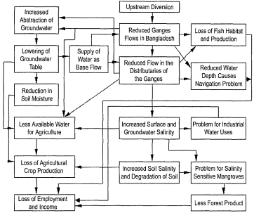
Impact of Water Diversion on Bangladesh
Source: Mirza 2004
Notes:
The impact of the barrage on Bangladesh has been severe, the crux of the problem also being the seasonal flow of the Ganges. The south-west part of the country is highly dependent on the Ganges flow which it receives through one of its distributary, the Gorai. But due to water diversion the discharge has reduced significantly causing droughts with an increase in variability. Peak discharge in the monsoons and water levels has also increased resulting in massive floods. In fact the barrage has destroyed the entire equilibrium and the changing hydraulic regime of the Ganges due to Farakka threaten the existence of the Gorai River in the future.

Slide 3
River bank erosion in Malda and Murshidabad
Mukherjee, Jenia. 2011 No voice, no choice: Riverine changes and human vulnerability in the ‘chars’ of Malda and Murshidabad, Occasional Paper 28 (Kolkata: Institute of Development Studies Kolkata 2011)
River bank erosion in Malda and Murshidabad
Notes:
There is an obvious relationship between Farakka Barrage construction and river-bank erosion in Malda and Murshidabad. The direction of the river flow has been altered and it is no longer co-axial to the barrage due to the reduction of the cross-sectional area and gradual meander formation between Rajmahal hills and Farakka. Being oblique, the flow concentrates more towards the right side of the barrage causing swelling of water during the peak of the monsoon.

Slide 4
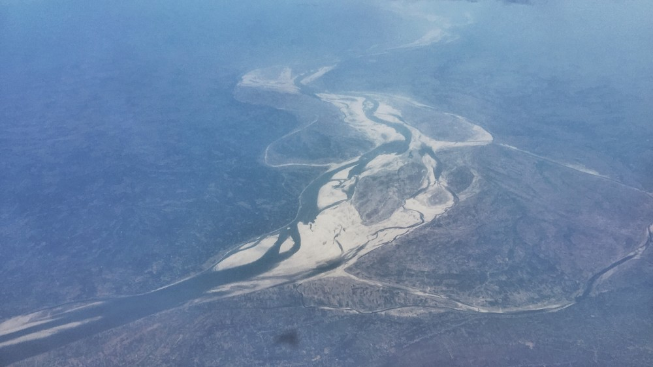
Chars
Notes:
In the post-barrage condition, the normal sediment transport system has been intercepted due to controlled operation of the barrage gates and the river bed on upstream started aggrading with the change of erosion/deposition pattern of river bed and banks. The new sand islands (‘chars’) have come up gradually with the general rise in river bed level and formation of deep narrow thalweg on left side.
Char formation nothing new…Colebrook, Sherwill and others…
From permanent to temporary chars

Slide 5
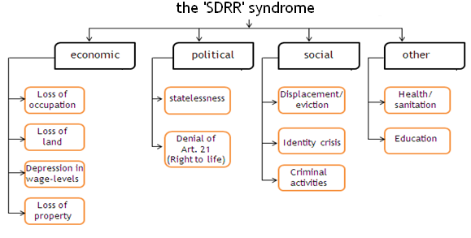
Source: Mukherjee 2011: 18

Slide 6
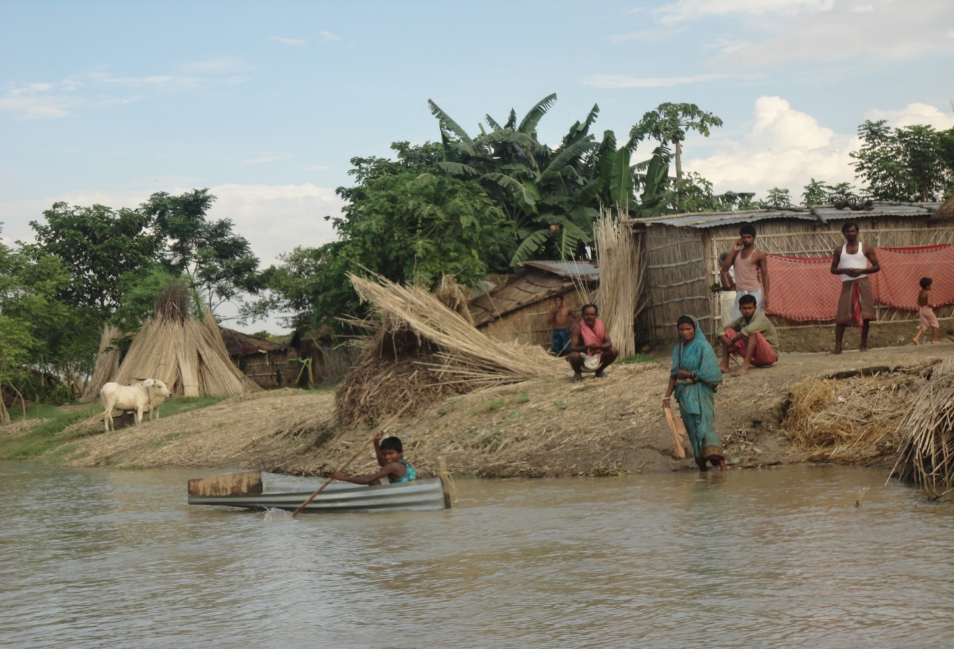

Slide 7
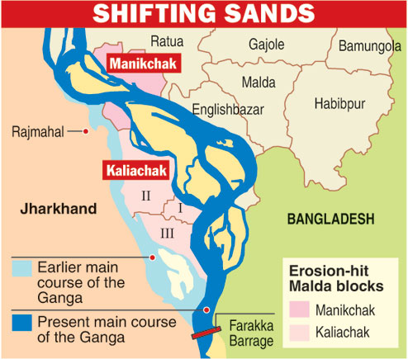
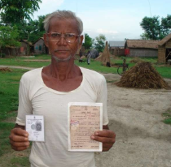
Notes:
Intra-state boundary issue

Slide 8
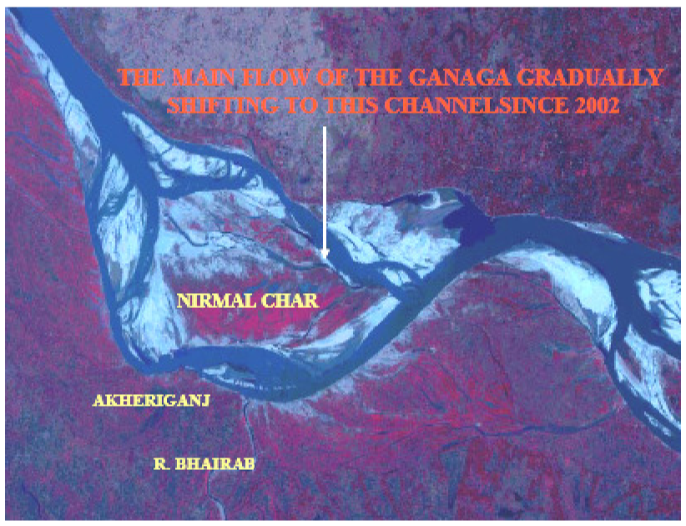
Source: Rudra 2003: 31
Notes:
1990 erosion – disappearance of Akheriganj; 25, 000 approx. people displaced
Appearance of the Nirmal char – border disputes; easily accessible from Rajsahi – Bangladeshi infiltrators

Slide 9
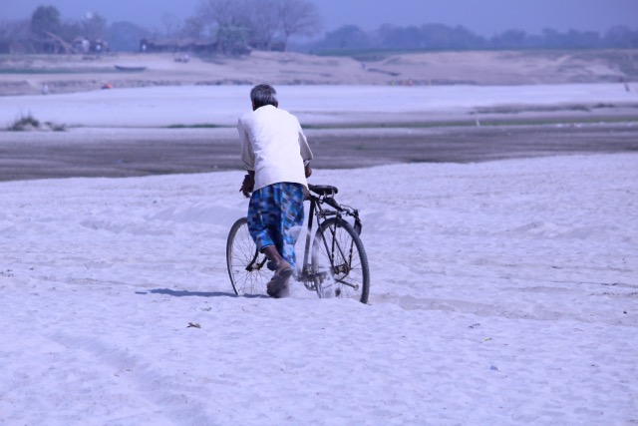
Life rolls on…
Dancing with (the moods) of the river
Coping up as a compulsory mechanism
Prevalence of ecosystem services
Chorua culture
Notes:
There is an obvious relationship between Farakka Barrage construction and river-bank erosion in Malda and Murshidabad. The direction of the river flow has been altered and it is no longer co-axial to the barrage due to the reduction of the cross-sectional area and gradual meander formation between Rajmahal hills and Farakka. Being oblique, the flow concentrates more towards the right side of the barrage causing swelling of water during the peak of the monsoon.

Slide 10
References
Iqbal, Showkat. 2017. Flood and Erosion Induced Population Displacements: A Socio-economic Case Study in the Gangetic Riverine Tract at Malda District, West Bengal, India. Journal of Human Ecology, Vol. 30 (3).
Lahiri Dutta, Kuntala and Samanta, Gopa. 2007. Like the Drifting Grains of Sand: Vulnerability, Security and Adjustment by Communities in the Charlands of the Damodar River, India. Journal of South Asian Studies. Vol. 30 (2).
Lahiri Dutta, Kuntala and Samanta, Gopa. 2013. Dancing with the River. Yale University Press.
Maitra, J. 2004. Boundary Dispute between West Bengal and Jharkhand: Correspondences and Documents. CPI(M) District Committee: Malda, West Bengal.
Mirza, M. M. Q. (ed). 2004. The Ganges Water Diversion: Environmental Effects and Implications. Netherlands: Kluwer Academic Publishers. 5.

Slide 11
References
Mukherjee, Jenia. 2011. No voice, no choice: Riverine changes and human vulnerability in the ‘chars’ of Malda and Murshidabad. Ocassional Paper 28. Kolkata: Institute of Development Studies Kolkata. 28.
Mukhopadhyay, Sutapa and Mukhopadhyay, Malay. Bank Erosion of River Ganga, Eastern India – A Threat to Environmental Systems Management. http://www.quebec2007.ca/pdf/salle204a/seance21/ articles/s_mukhopadhyay.pdf (accessed on April 22, 2018).
Parua, P.K. 1999. Erosion Problems of the River Ganga in the districts of Malda and Murshidabad in West Bengal. Civil Engineering Today, Journal of ASCE. Vol. 13 (2).
Rudra, Kalyan. 2000. Living On the Edge: The Experience along The Bank of the Ganga in Malda District, West Bengal. Indian Journal of Geography & Environment. Vol. 5. 57-67.

Slide 12


